Slide 2
SRL Mechanix Session 072
Randy Brooks
Randy_Brooks@lovejoyisd.net

Slide 3
MECHANIX
Randy Brooks
Lovejoy ISD
PLTW Summit 2016 – Session 072
March 21, 2016

Slide 4
MECHANIX
Sketch-based online tutorial supporting truss, vector, and free-body diagram analysis which provides constructive feedback to students and student-level metrics to instructors, anytime, anywhere.

Slide 5
Randy Brooks
23 years in Telecom
6th year at Lovejoy High
2nd year in PLTW – PoE
Vision for quality, engaging online courses
TCEA presenter 2014/2015 regarding Flipped and Online courses

Slide 6
Randy Brooks
Driver for quality, engaging online courses
Online course success very dependent on effectiveness of online supports
Flipped PreCalculus classroom
Problem-Solving with Brooks
Plethora of online supports and tools for students
Purdue Learning Design and Technology (LDT) Masters Program

Slide 7
PoE Digital Aspects
West Point Bridge Design
Coursera Georgia Tech MOOC addressing ‘Statics’
PBSLearningMedia Online Tools
Weebly/Wix website construction
Mechanix
PhET - University of Colorado
GoogleDrive
PLTW Canvas

Slide 8
Texas A&M University

Slide 9
TEXAS A&M E³
Two week summer immersion for educators,
Paired with professors requiring research, and
Several group discussions and tours involving various university organizations which are progressing STEM initiatives.

Slide 11
TAMU Computer Science & Engineering
Dr. Tracy Hammond
Columbia/MIT
Anthropology/Math/Physics
Finance Technology/EECS
CompSci Artificial Intelligence Lab
Passion for computer simulation of human activity.
TAMU CompSci Video

Slide 12
MECHANIX

Slide 13
Mechanix Relevancy
Truss analysis is a key concept in PLTW Principles of Engineering.
A driver for development of Mechanix was a need for support in first year college engineering courses.
Truss analysis has a feedback heavy learning cycle, rarely yes/no.

Slide 14
Mechanix Relevancy
This past summer two High School Physics teachers and myself worked with the TAMU SRL to tune Mechanix to support vector and free-body diagram analysis.
We have all brought Mechanix into our classrooms and are providing feedback to SRL regarding our observations.

Slide 15
Before we begin digging through some details…
here are a few screen shots of MECHANIX in operation…

Slide 17
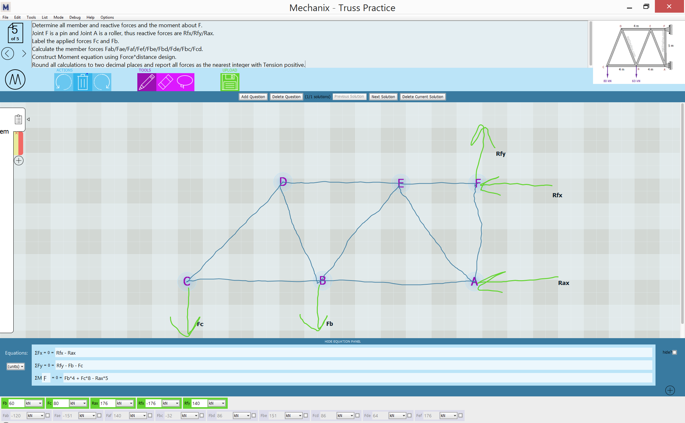

Slide 18
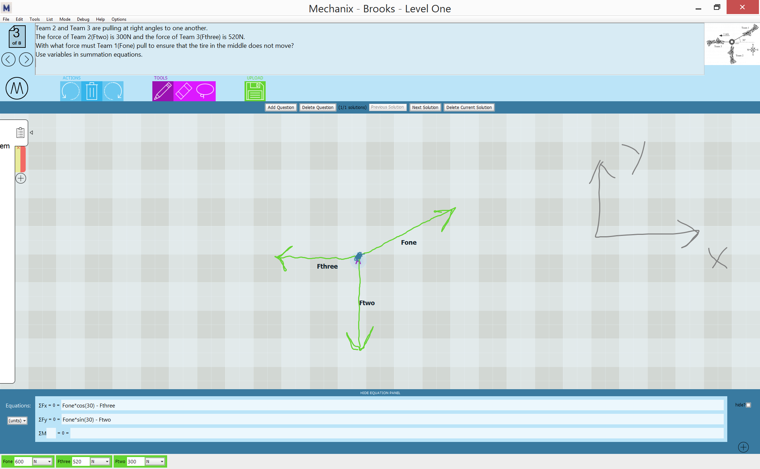

Slide 20
And here is a brief example of Mechanix in action…
You will experience both the instructor and student views of a problem…

Slide 21
Mechanix in Action

Slide 22
MECHANIX BASICS
Client-Server design such that student and instructor are always accessing the most recent version of the program.
Java Network Launch available on the Mechanix website establishes connectivity.
Public use is available, or the SRL can set-up classes with ID/PW.

Slide 23
http://faculty.cse.tamu.edu/hammond/mechanix.php

Slide 24
MECHANIX BASICS
Instructor enters the question including a visual and sketches the solution in Mechanix.
Questions/Solutions may be designed in groups and reordered.
When complete, the instructor submits the problem set to be completed by the students.

Slide 25
MECHANIX BASICS
Students access the problem set released by the instructor and begin solving the question of their choice. They do not have to be solved in order.
When a student is either satisfied with their solution, or stumped, they ask Mechanix to ‘Check?’ what they have sketched.

Slide 26
MECHANIX BASICS
Mechanix then returns a green drop down bar containing ‘Correct!’, or an orange bar containing dialogue as to what is missing or erroneous.
If no green bar, the student then addresses the issue and resubmits. The cycle continues until green is received and the student moves on to another challenge.

Slide 27
MECHANIX BASICS
Once students have tried to address the questions, the instructor can access data at the student level with several relevant metrics.
Speed to solution.
Number of submissions.
Returned error log.

Slide 28
MECHANIX WRAP-UP
Enhancements are coming this semester.
This tool is a tangible vision of an enhanced and effective online tutor.
Pen and Touch Technology.
NSF-funded project.
Myriad presentations in industry forums.
SRL focused on production of tools which mimic human activity and interaction.

Slide 29
MECHANIX

Slide 30
Randy Brooks Lovejoy ISD Lucas, Texas (near Dallas)
Twitter – Randy Brooks@MathFella
Randy_Brooks@lovejoyisd.net

